Slide 1

RAGHU INSTITUTE OF TECHNOLOGY
DEPARTMENT OF COMPUTER SCIENCE & ENGINEERING
Accredited by NAAC A+ and NBA, Affiliated to JNTU-GV(Vizianagaram)
Dakamarri (V), Bheemunipatnam (M), Visakhapatnam
Machine learning algorithm for learning disability detection and classifier system
Presented By – BATCH 42 (CSE-F):
V. Nikitha (213J1A05H7)
V. Joshika Siddani (213J1A05I5)
N. Manikanta Swamy (213J1A05D6)
P. Uday Rishi (213J5A05D5)
Under the esteemed guidance of,
Mr. B. Chakradhar (Ph.D),
Assistant Professor,
Department Of CSE

Slide 2
INDEX
Abstract
Literature Survey
Proposed System
Implementation
Results
Conclusion

Slide 3
ABSTRACT
Early detection of learning disabilities is crucial for effective support.
EEG data is used with machine learning to classify learning disorders.
Data preprocessing includes handling missing values, normalizing, and encoding labels.
An RNN-LSTM model captures EEG signal patterns.
The dataset is split 80% training – 20% testing.
The model is trained using Adam optimizer and cross-entropy loss for 20 epochs.
Performance is evaluated using confusion matrices and classification reports.
A Gradio-based web interface allows doctors and psychologists to analyze EEG data.
The system helps detect Dyslexia, ASD, and ADHD.

Slide 4
LITERATURE SURVEY
Year | Author | Title | Outcomes
2021 | A. Devi, Dr. G. Kavya, M. Julie Therese, R. Gayathri | -Early Diagnosing and Identifying Tool for Specific Learning Disability using Decision Tree Algorithm | -Proposed a decision tree-based system for early diagnosis of learning disabilities, improving classification accuracy and efficiency.
2020 | Drotar, P., Dobes, M. | -Dysgraphia detection through machine learning | -Developed a machine learning-based approach for detecting dysgraphia, improving early identification and intervention.
2018 | Khan, Rehman, Lee, Julia, Oon, Yin Bee | -Machine Learning and Dyslexia: Diagnostic and Classification System (DCS) for Kids with Learning Disabilities | -Developed a diagnostic and classification system using machine learning for dyslexia detection in children, improving early identification and support strategies.
2015 - 16 | K. Ambili, P. Afsar | -A Framework for Learning Disability Prediction in School Children using Naive Bayes - Neural Network Fusion Technique | -Proposed a hybrid Naïve Bayes-Neural Network model for predicting learning disabilities in school children, improving classification accuracy.
2013 | Pooja Manghirmalani Mishra, Dr. Sushil Kulkarni | -Classification of Data using Semi-Supervised Learning (A Learning Disability Case Study) | -Explored semi-supervised learning techniques for classifying learning disabilities, enhancing predictive accuracy with limited labeled data.
2009 | H. Atakan Varol, Subramani Mani, Donald L. Compton, Lynn S. Fuchs, Douglas Fuchs | -Early Prediction of Reading Disability using Machine Learning | -Developed a machine learning model for early reading disability detection, enhancing early intervention strategies.

Slide 5
PROPOSED SYSTEM
The proposed system leverages EEG-based deep learning models (RNN & LSTM) to detect and classify learning disabilities like ADHD, dyslexia, and ASD.
Unlike traditional methods, it analyzes sequential brain activity to improve accuracy and early diagnosis.
The model is trained on preprocessed EEG data.
Deployed through a Gradio-based user-friendly interface for real-time and accessible predictions.
Enables educators, psychologists, and parents to analyze data easily.
Enhances efficiency, objectivity, and scalability in learning disability detection.

Slide 6
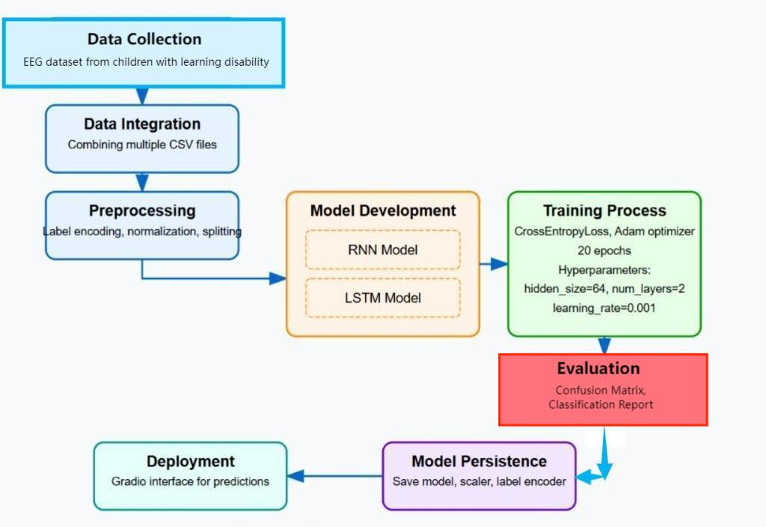
Fig 1: EEG-based Learning Disorder Classification: Methodology Flow

Slide 7
Implementation
1.Data Collection & Loading
EEG dataset stored in Google Drive.
Multiple CSV files containing EEG readings.
Files loaded dynamically, non-empty data filtered, and class labels assigned.
2.Data Preprocessing
Merge all CSV files into a single dataset.
Handle missing values by replacing them with column means.
Encode class labels into numerical values.
Standardize features for consistency.
3.Data Splitting
Split data into 80% training and 20% testing.
Reshape data for LSTM processing.

Slide 8
4.Model Design: RNN & LSTM
Recurrent Neural Networks (RNNs)
RNNs are designed for sequential data, where previous inputs influence the current output.
They have hidden states that store past information, making them useful for time-series and pattern recognition tasks.
However, standard RNNs suffer from the vanishing gradient problem, making it difficult to learn long-term dependencies.
Long Short-Term Memory (LSTM)
LSTMs are an advanced type of RNN designed to overcome the vanishing gradient problem.
They introduce memory cells with gates (input, forget, and output gates) to control the flow of information.
LSTMs are ideal for learning long-term dependencies, making them effective for task like EEG signal classification.

Slide 9
5.Model Training
Uses Cross-Entropy Loss and Adam Optimizer.
Trained for 20 epochs with backpropagation.
6.Model Evaluation
Predictions made on test data.
Performance assessed using Confusion Matrix and Classification Report.
7.Model Deployment
Trained model saved for future use.
Gradio-based web interface for real-time disorder predictions.

Slide 10
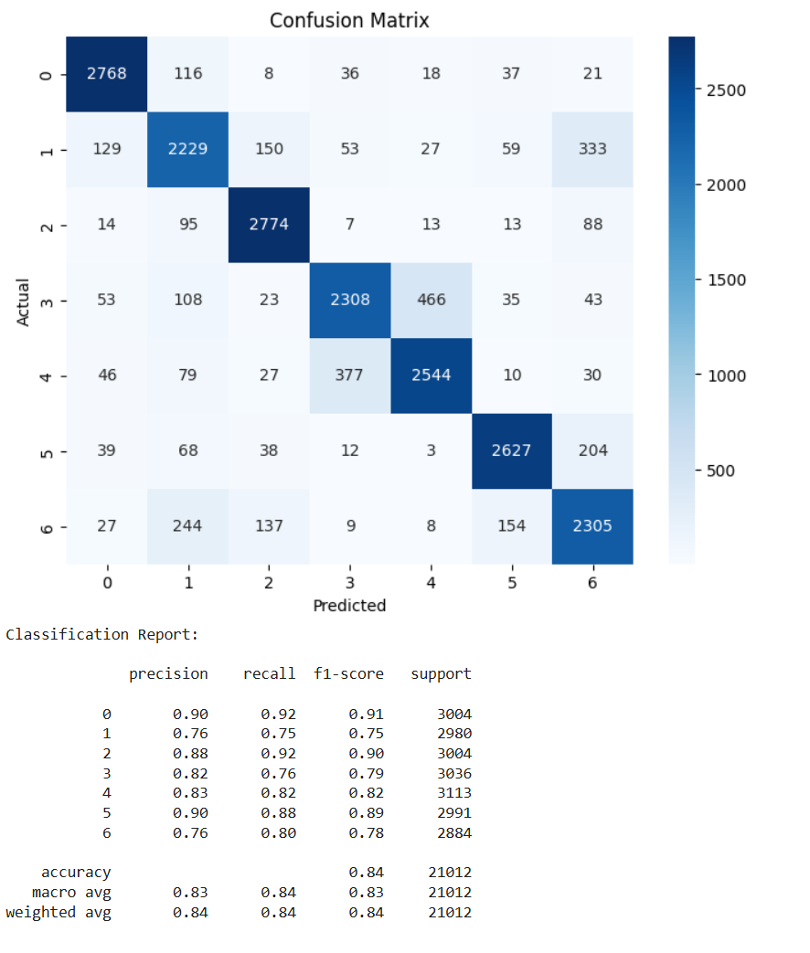
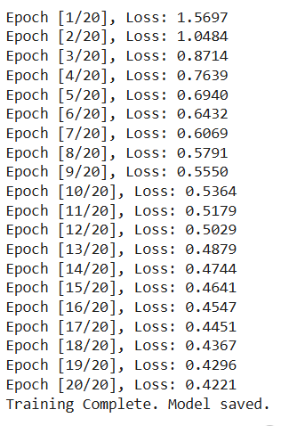
Results
Fig 2 : RNN Training Model
Fig 3: RNNs Confusion Matrix and Classification Report
The RNN model's training progress, where the loss decreases over 20 epochs, indicating effective learning. The confusion matrix and classification report confirm an 84% accuracy, demonstrating strong classification performance.

Slide 11
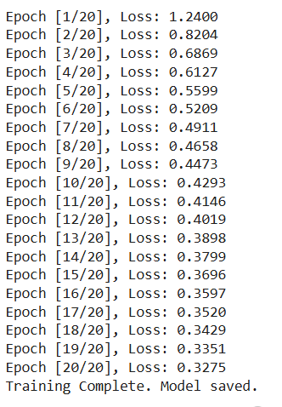
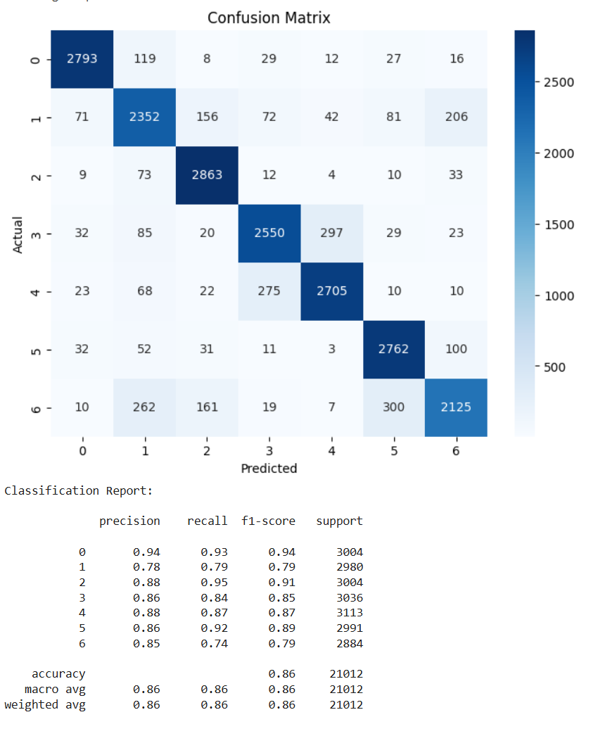
Fig 4: LSTM Training Model
Fig 5: LSTMs Confusion Matrix and Classification Report
The LSTM model's training process, where the loss decreases over 20 epochs, indicating improved learning. The confusion matrix and classification report show an 86% accuracy, highlighting better classification performance than RNN.

Slide 12
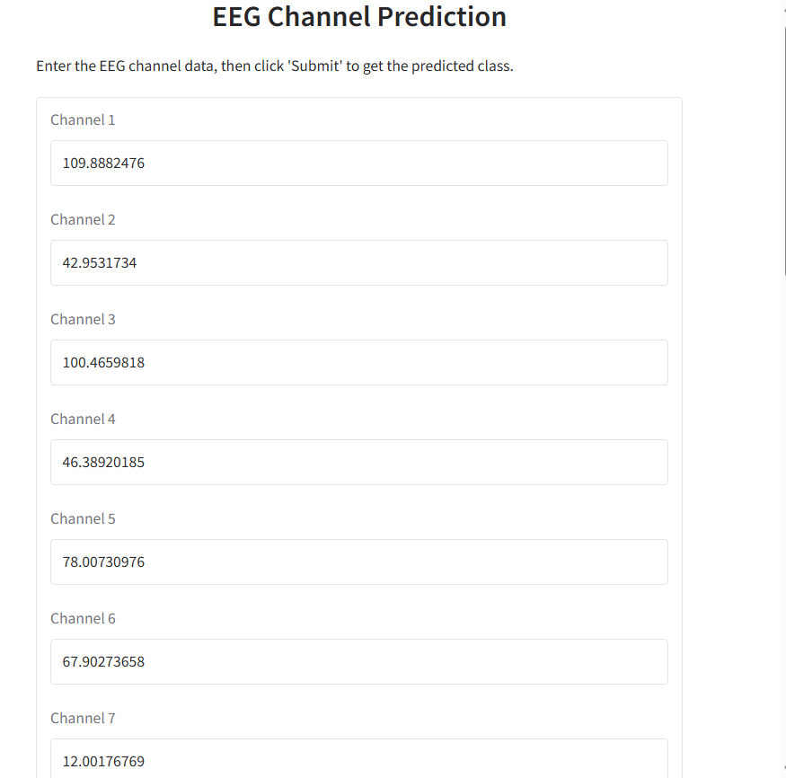
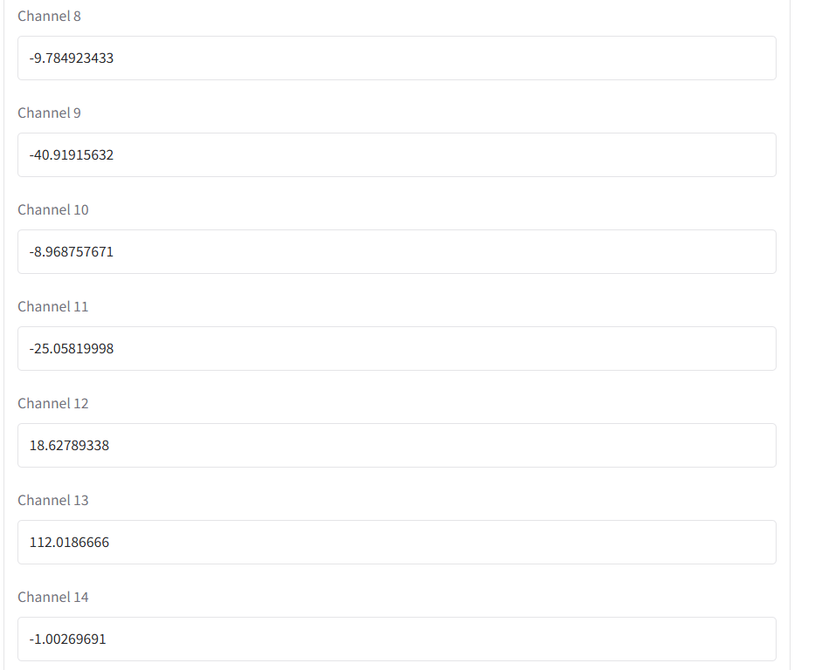
USER INTERFACE

Slide 13
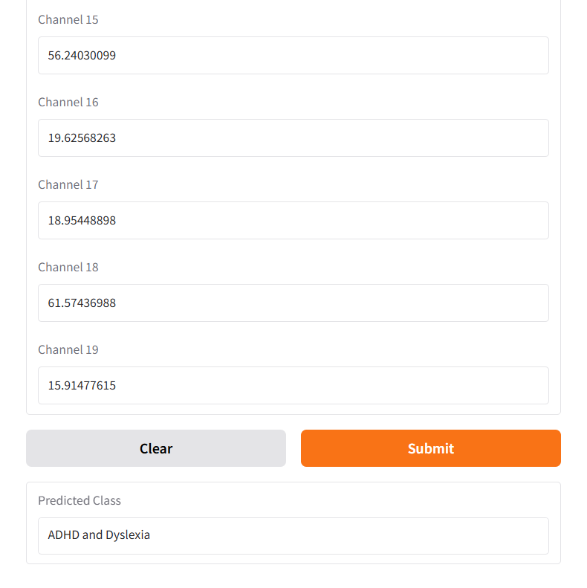
PREDICTION:
User getting the output based on the input values.

Slide 14
CONCLUSION
The effectiveness of LSTM-based deep learning in detecting learning disabilities using EEG data .By capturing temporal patterns , the model shows higher accuracy (86%) than RNNs, with reduced loss and better classification. The Gradio-based web interface makes it accessible for educators and doctors, enabling quick and reliable diagnosis. This approach supports early detection and intervention, improving outcomes for affected individuals.

Slide 15
THANK YOU

